Slide 1
Smart Adaptive Temperature Control System
Futuristic Model

Slide 2
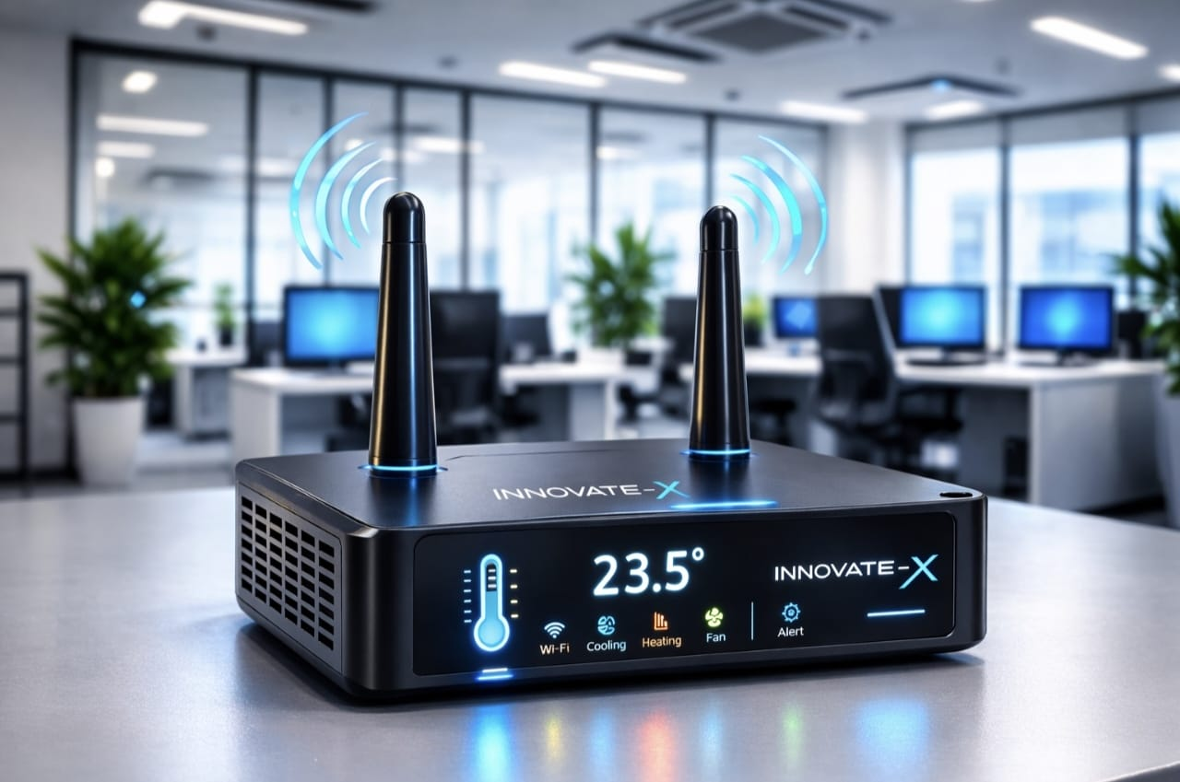
Additional Advanced Features:
Wi-Fi and IoT connectivity
Automatic device detection
Mobile app monitoring
Cloud dashboard
AI predictive control
Voice assistant integration
Building-wide centralized control
Energy analytics & Portable Solar-Powered Smart Control

Slide 3
Voice Assistant Integration
Smart Voice-Controlled Temperature Assistant
Our futuristic temperature control system includes an advanced AI Voice Assistant feature similar to Amazon Alexa.
Users can communicate with the device naturally using voice commands without touching any switches or mobile apps.
The system can:
Listen to user voice commands
Reply with current temperature details
Automatically adjust room temperature
Control connected devices such as:
  Air Conditioner (AC)
  Fan
  Heater
  Smart Windows
Example Voice Commands
“What is the current room temperature?”
“It’s too cold, reduce the cooling.”
“Increase the temperature by 2 degrees.”
“Turn on the fan.”
“Switch off the heater.”
Intelligent Features
Real-time voice interaction
AI-based temperature suggestions
Hands-free smart home control
Personalized comfort settings
Multi-device automatic synchronization
Voice alerts for abnormal temperature conditions

Slide 4
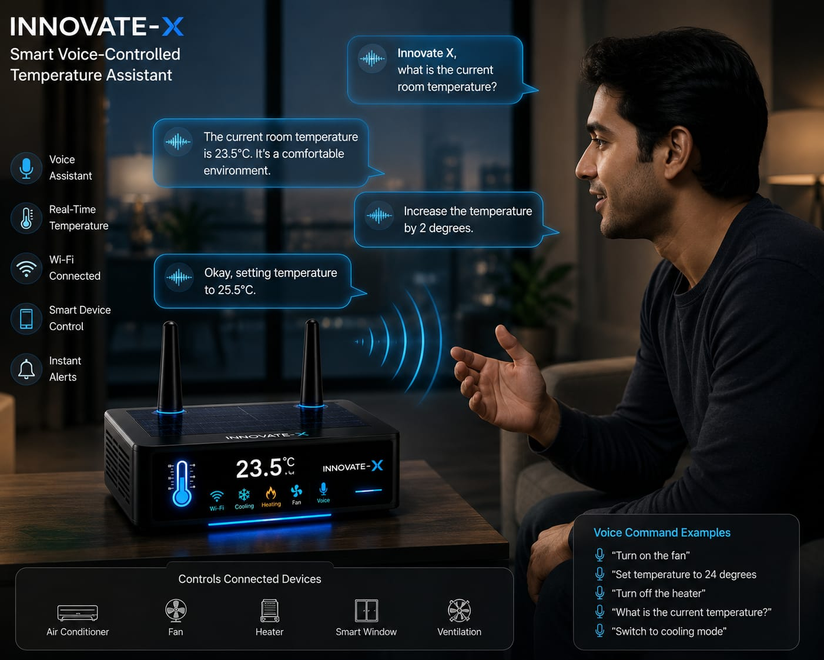

Slide 5
Portable Solar-Powered Smart Control
Our futuristic smart temperature control system is designed with a powerful built-in battery and solar panel integration.
Because of this advanced energy system, the device does not require continuous charging or external power connections.
Users can simply carry the device and temporarily place it inside any building, room, office, or hall.
Once installed, the system automatically connects with all nearby smart devices such as:
The device includes:
☀️ High-efficiency solar panels
🔋 Long-lasting rechargeable battery
⚡ Automatic solar charging system
🌱 Eco-friendly energy management
Smart Portable Features
No manual charging required
Easy to carry and install anywhere
Temporary or permanent deployment support
Wireless device synchronization
Energy-efficient smart automation
Continuous operation during power failures

Slide 6
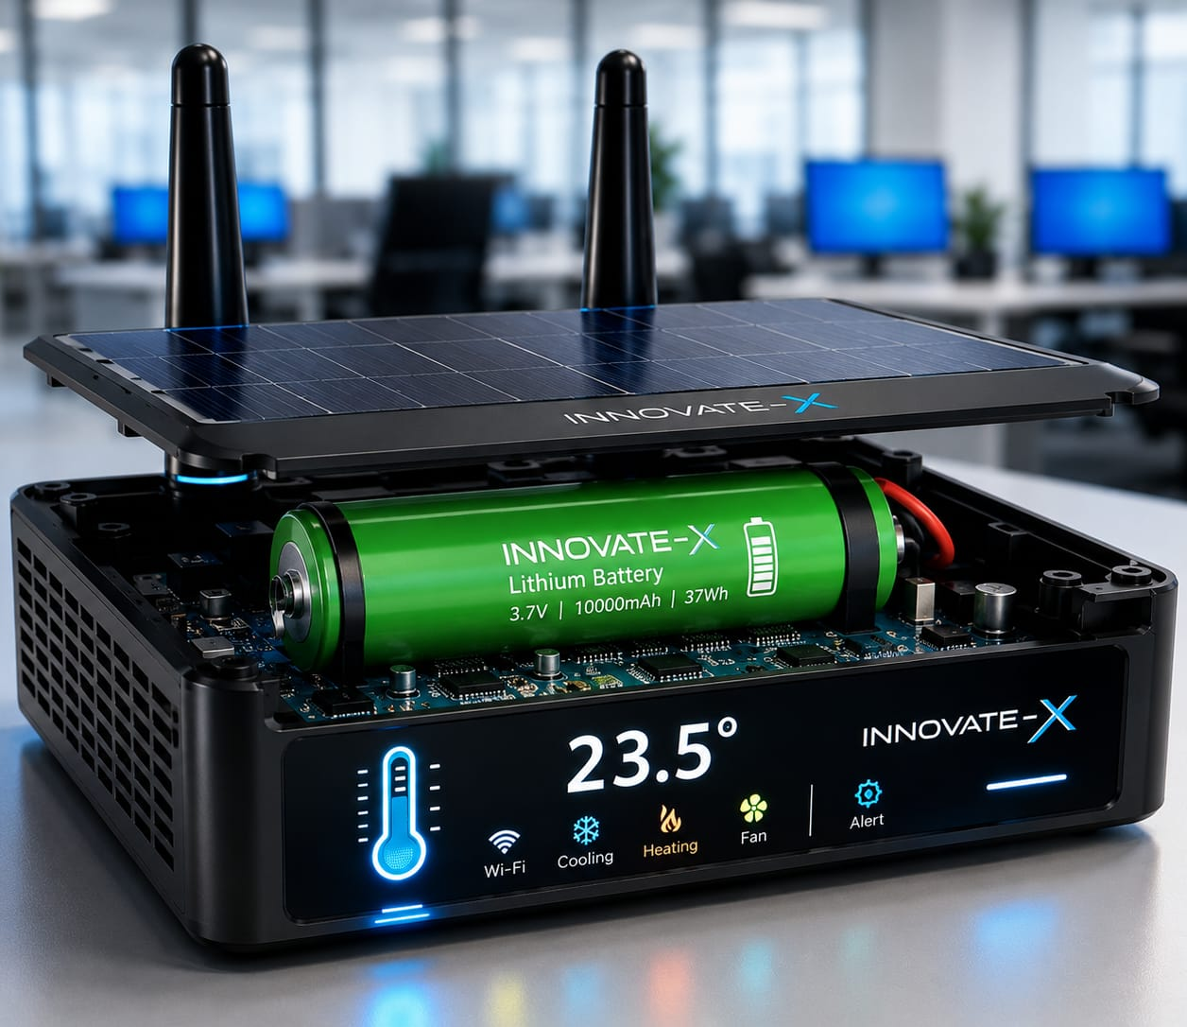
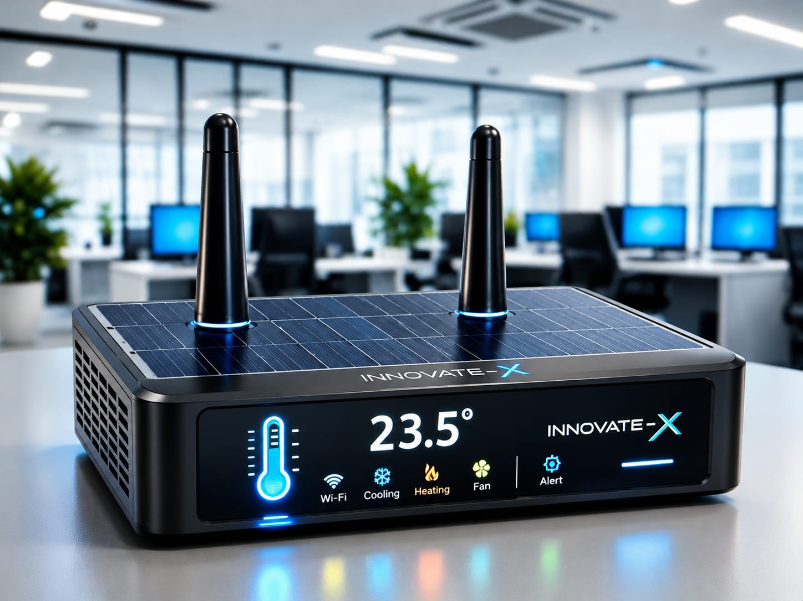
Portable Solar-Powered Smart Control

Slide 7
REAL TIME FAULT DETECTION
AI-Based Smart Suggestions
The system can also provide intelligent recommendations such as:
Check Heater Connection
Power Supply Failure Detected
Reconnect Wi-Fi Device
Replace Faulty Component
Smart Fault Analysis
The system can identify:
Which device failed
Exact location of the device
Type of issue
Time of failure

Slide 8
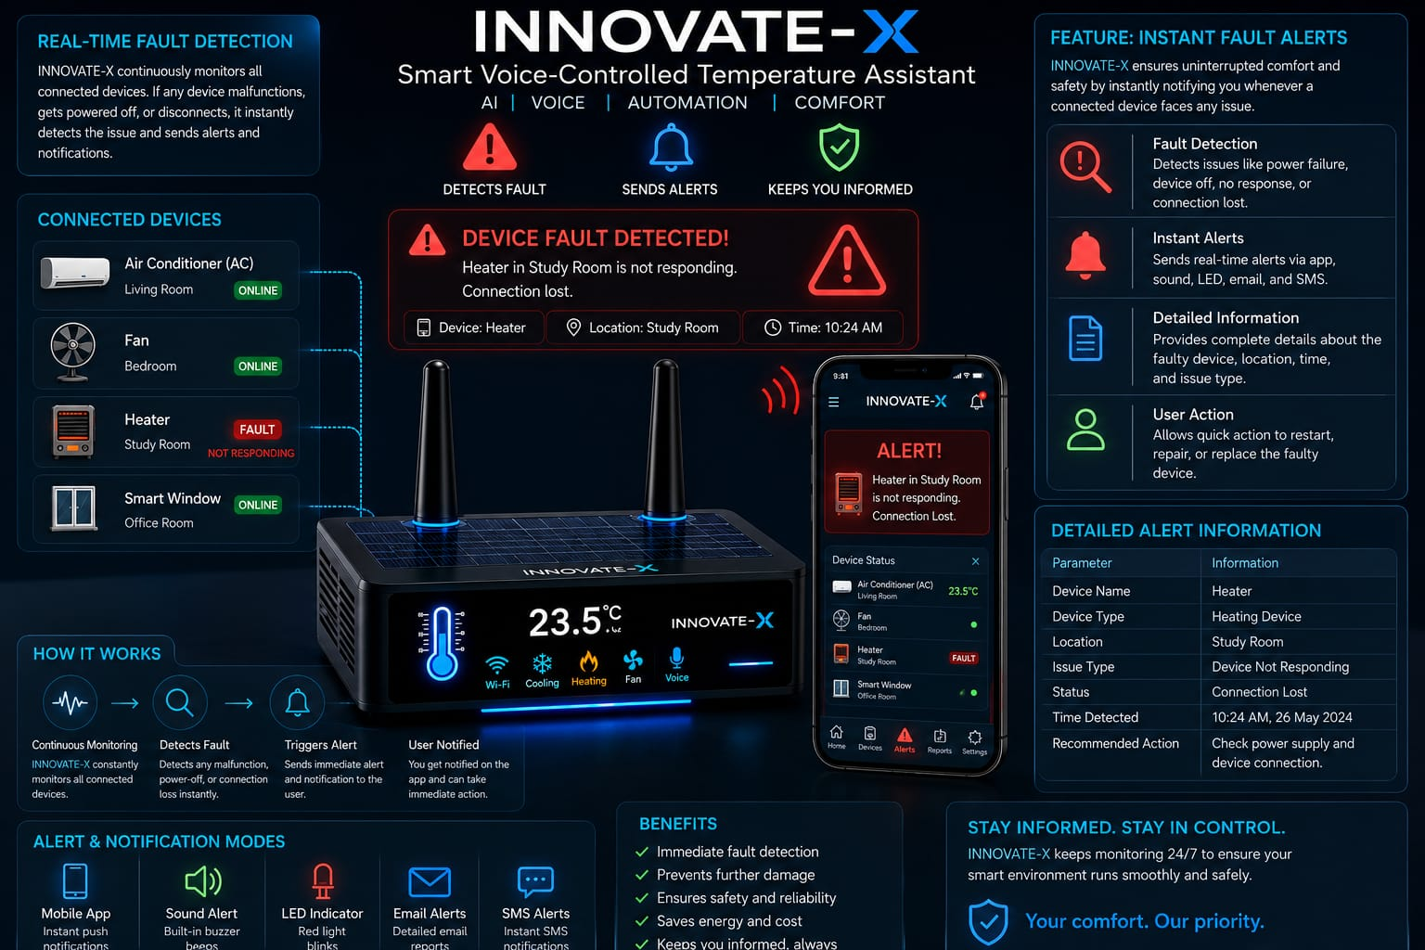

Slide 9
Thank You
INNOVATE X5

